Slide 1
Penetration Testing
Capturing Traffic
Dr. Tran The Son
Vietnam – Korea University

Slide 2
Content
Using Wireshark
ARP Caching Poisoning
DNS Caching Poisoning
SSL Attacks
SSL Stripping

Slide 3
capturing traffic from other systems in the network can give us additional interesting information (perhaps even usernames and passwords) that can help us with exploitation.
selecting promiscuous mode on/off
  ON: capturing other systems’ traffic (every packets)
  OFF: capturing traffic from our target virtual machines

Slide 4

Wireshark
Wireshark is a graphical network protocol analyzer
Capture
    Ethernet, wireless, Bluetooth, and many other kinds of traffic.
Capture > Options, and selecting the eth0/wlan0 option
Remember to uncheck the Use promiscuous mode on all interfaces option so that the results will be like those on a physical switched network rather than the VMware network.

Slide 5
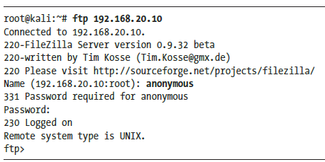
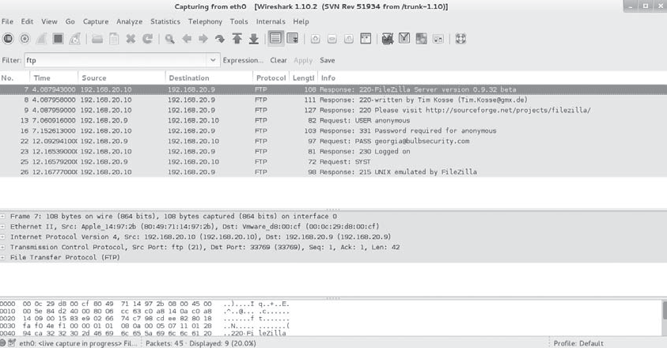
Filtering Traffic
Enter ftp in the Filter field
….and more

Slide 6
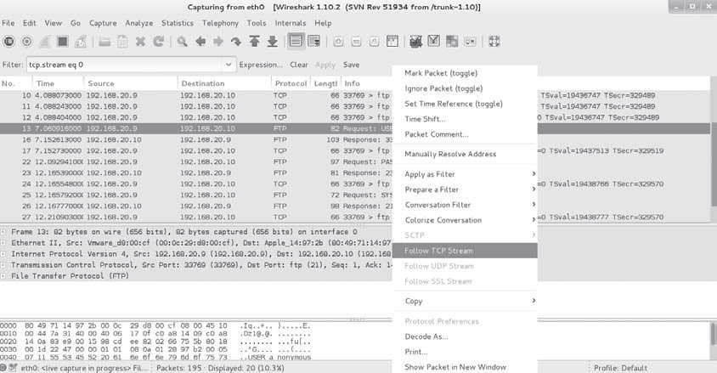
Following a TCP Stream
once we find an interesting packet, such as the beginning of an FTP login, we can dig deeper into the conversation by selecting Follow TCP Stream

Slide 7
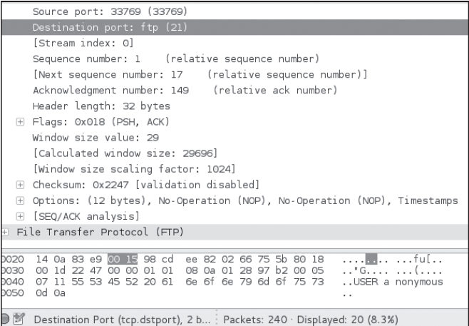
Dissecting Packets
At the bottom of the Wireshark screen, you can see details of the selected packet

Slide 8
ARP Cache Poisoning
To capture traffic not intended for the Kali system, we need to find some way to have the relevant data sent to our Kali system.
  man-in-the-middle attack: redirect and intercept traffic between two systems
Address Resolution Protocol (ARP) cache poisoning (ARP spoofing)

Slide 9
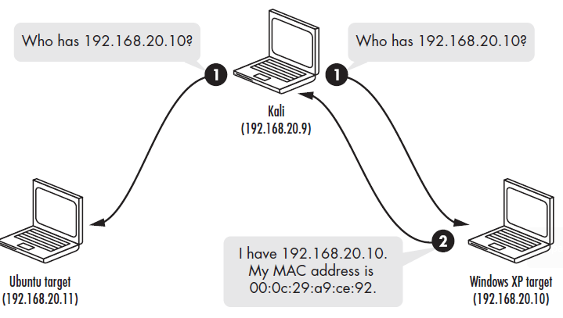
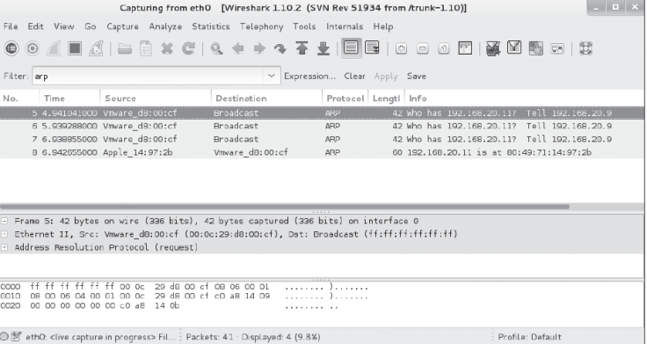
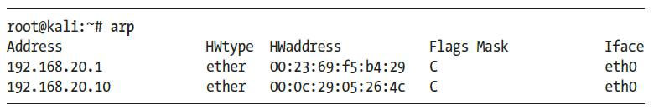
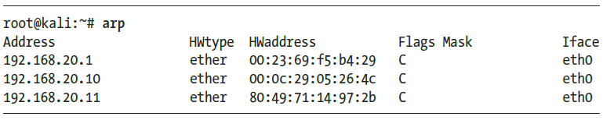
ARP Basics

Slide 10
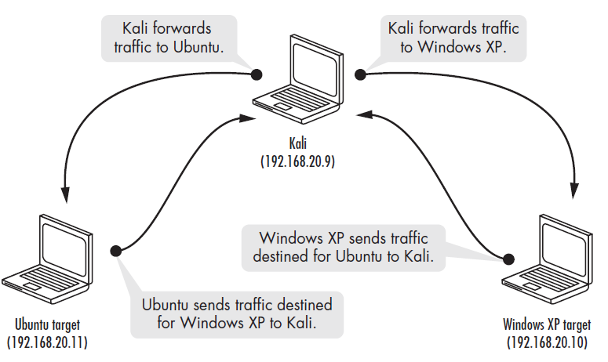
ARP Cache Poisoning
ARP cache poisoning redirects traffic through Kali
Using an ARP cache poisoning attack, we can trick the two systems into sending their traffic to our Kali machine instead, to be captured in Wireshark

Slide 11

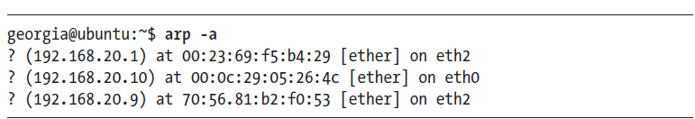
IP Forwarding
we need to turn on IP forwarding to tell our Kali machine to forward any extraneous packets it receives to their proper destination
    The setting for IP forwarding on Kali is in /proc/sys/net/ipv4/ip_forward.

Slide 12
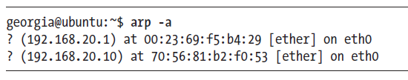
ARP Cache Poisoning with Arpspoof
One easy-to-use tool for ARP cache poisoning is Arpspoof. To use Arpspoof, we tell it which network interface to use, the target of our ARP cache poisoning attack, and the IP address we would like to masquerade as.
-i: interface
-t: target
-r: host

Slide 13
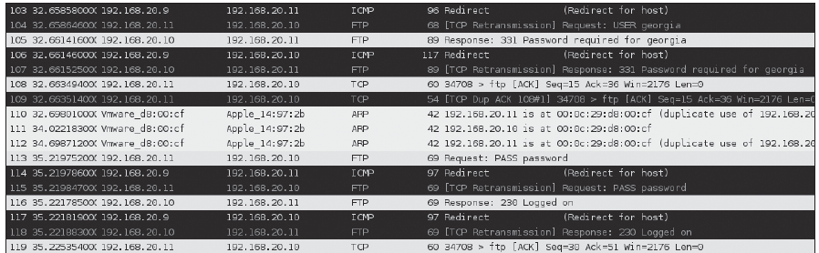
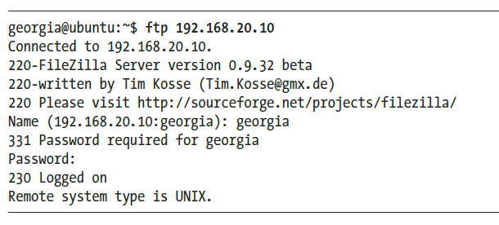
ARP Cache Poisoning with Arpspoof

Slide 14
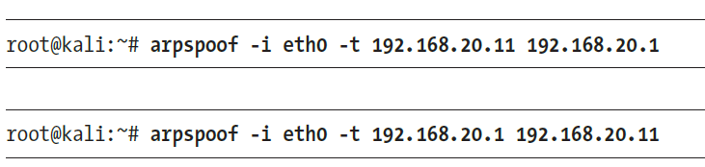
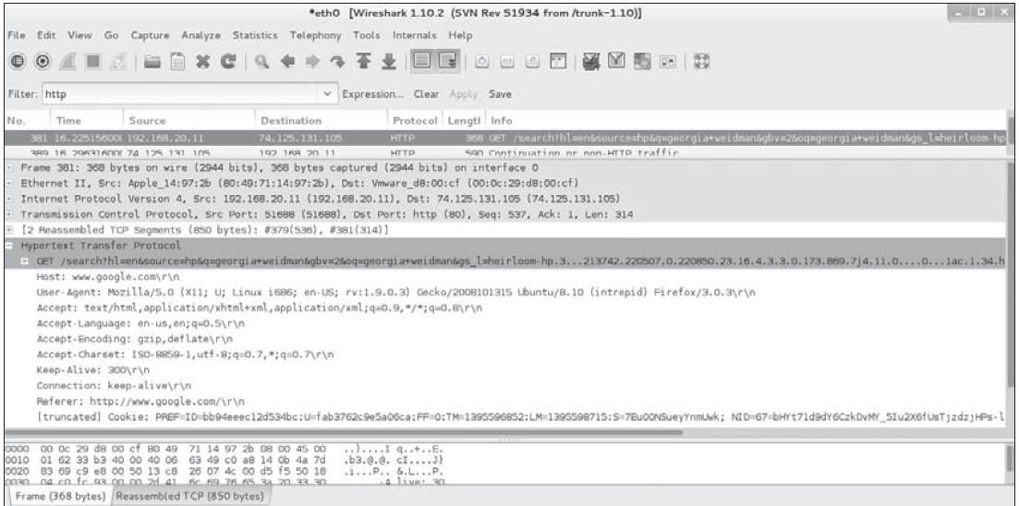
Using ARP Cache Poisoning to Impersonate the Default Gateway

Slide 15
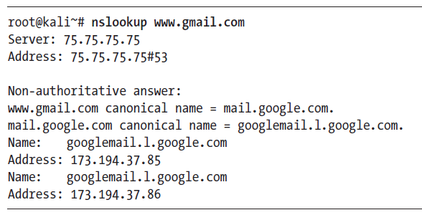
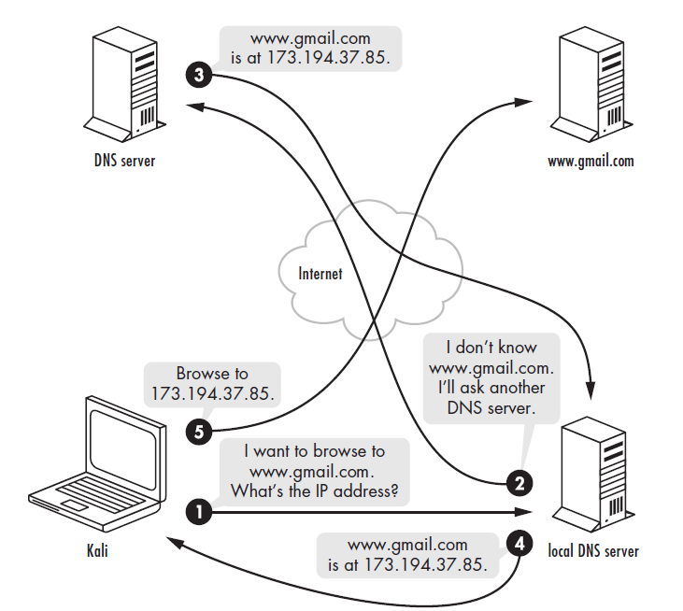
DNS Cache Poisoning

Slide 16


Using Dnsspoof
Get started
  make sure the Apache server is running
  Kali machine adds the entry to hosts.txt
    192.168.20.9 mail.google.com
  Restart Arpspoof between the Linux target and the default gateway and vice versa

Slide 17

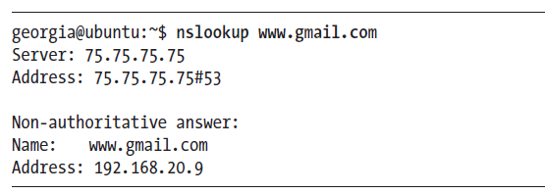
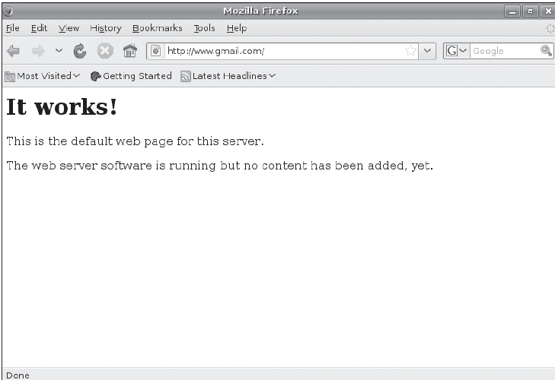
Using Dnsspoof at Kali machine
Check at target (e.g. Window XP)

Slide 18
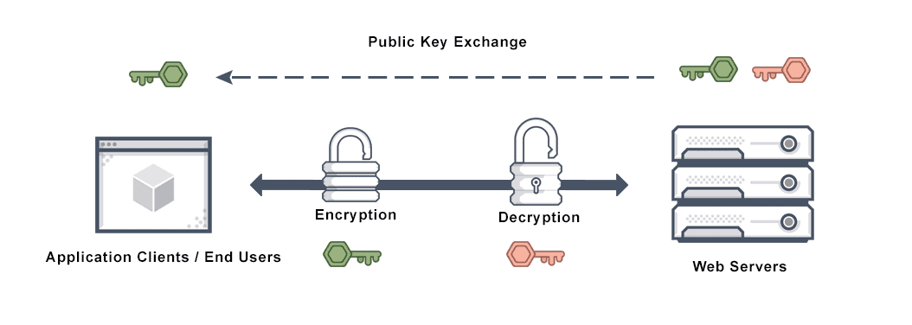
SSL Attacks
SSL Basics
  An SSL certificate is a digital certificate that authenticates a website's identity and enables an encrypted connection. SSL stands for Secure Sockets Layer, a security protocol that creates an encrypted link between a web server and a web browser.
  SSL was replaced by an updated protocol called TLS (Transport Layer Security) some time ago.

Slide 19
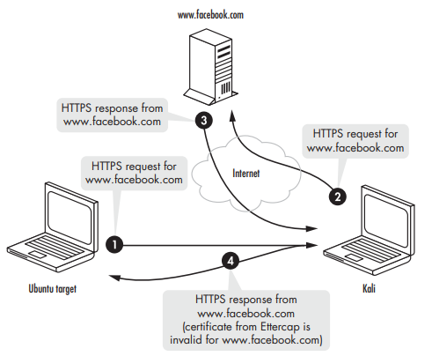
SSL Attacks
Using Ettercap for SSL Man-in-the-Middle Attacks
  just wait for users to start interacting with SSL-based web servers
Turn off any other spoofing tools before starting Ettercap

Slide 20
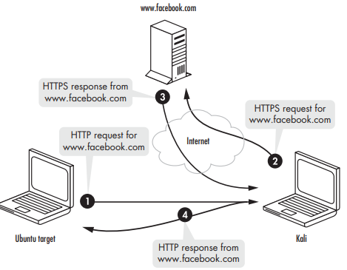
SSL Stripping

Slide 21

Using SSLstrip

